Slide 1

Geotagging space and Aviation
Team: Ascension

Slide 2
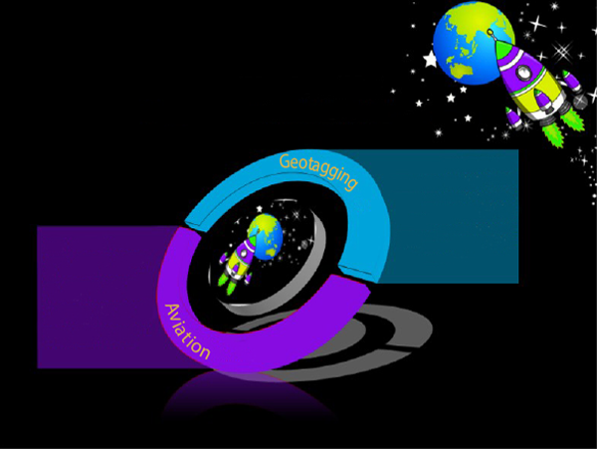
A FEW WORDS ABOUT…
Geotagging is the process of adding geographical identification metadata to various media such as a geotagged photographs, videos or websites.
Aviation is the practical aspect or art of aeronautics, being the design, development, production, operation and use of aircraft, especially heavier than air aircraft.

Slide 3
WHAT DOES THIS APPLICATION DO?
This app was created to collect information about locations around the world, their history , some of their celebrities and famous buildings.

Slide 4
WHAT DOES THIS APPLICATION DO?
Also it provides you with some extra information like does the city participate in the NASA Space App challenge and some information about the attractions.

Slide 5
FEATURES THAT THIS APPLICATION OFFERS :
Navigation
World map
Information about locations around the world (their history, attractions etc.)

